Slide 1
MRN Guidelines for IHO
S-100 TSM6
18-20 September 2018
Eivind Mong
Raphael Malyankar
Sponsored by NOAA

Slide 2
MRN Background
Top level name space is urn:mrn
IALA developed based on uniform resource identifier (URI) is defined in RFC 3986 (http://tools.ietf.org/html/rfc3986)
Governed by IALA through mrnregistry.org
MRN added to S-100 4.0.0 (3-10 & 11-7.4) as the recommended Globally Unique Identifier (GUID).
IHO has been granted urn:mrn:iho, and should define management rules.
Notes:
IALA is working on their own guidelines, so IHO can influence IALA development by presenting its own rules. Harmonized rules within e-Navigation will be advantageous. IALA ENAV23 in early October will be a good venue to submit IHO guidelines as an information paper.

Slide 3
Two levels of guidance for IHO suggested
IHO level
Applies to all of IHO, e.g. publications, standards, products and the Member State level.
Specific guidance included.
Member State level
Applies to solely to Member State level.
Should be general guidance to permit Member States to adopt to their specific needs.

Slide 4
IHO Level guidance
Governing body needed for the management of the IHO MRN domain
Suggested to be done in a similar way as S-62, with the IHO Secretariat managing the domain on behalf of IHO.
Public location (e.g. IHO website or GI Registry) for publishing the designated MRN namespaces should be set up.

Slide 5
IHO Level guidance – high level rules
Establish ranges of reserved codes, such as producer codes, and other codes (product, publication, etc.).
For use during development of specifications (S100, S101, etc.).
For example, JS00 should be a reserved producer code for “Jussland” test datasets.
Producer codes should follow the recommendation given in S-100WG3-6.4

Slide 6
IHO Level guidance – high level rules
MRN specification gives no limit to the length of a MRN.
Length of an MRN adds to the byte size of a dataset, and longer MRNs add more than shorter ones.
The urn:mrn:iho part is 11 bytes, and additional characters will add one byte per character, per instance.
Some flexibility may be useful in the length to give sufficient space to give enough space for different cataloging purposes.
Recommended that maximum length of IHO MRN should 128 bytes.

Slide 7
IHO Level guidance – high level rules
MRN GUIDs should be preserved throughout an object’s lifetime.
Including when objects are reused in new products.
For traceability source of an object.
Enable user systems to link instances of the same object across products.
Whether one data object is the same as another can be complex.
Different data products or different versions of the same product may add or remove attributes,
Coordinates may be different at different scales
the number of points in a curve, surface boundary, multipoint
grid may be different resolution
spatial primitive may change as scale increases or decreases
feature geometries may be merged at some scale
Need guidance to help producers decide
Notes:
More on the question of one data object being the same or not later.

Slide 8
IHO Level guidance – IHO Publications
For IHO Publications it will be useful to have a namespace for publications, followed by a few distinguishing characteristics for the individual publication to aid in distinguishability, and to make the MRN ID globally unique.
Proposing this format of the Publications MRN:
urn:mrn:iho:pub:<publication type>:<publication name or number>:<edition number>:<correction number>:<clarification number>:<optional and additional version information>
<pub> a fixed namespace for publications.
<optional and additional version information> can be used for additional name spaces as per need.
IHO’s current publication types and proposed codes for these are;
Bathymetric Publications - bathy;
Capacity Building Publications - cb;
Miscellaneous (Base Regulatory Publications) - reg;
Periodic Publications - per;
Standards and Specifications - spec.
For example S-57 with supplement 3 can be given the following MRN identifier;
urn:mrn:iho:pub:spec:s57:3:1:supplement3

Slide 9
IHO Level guidance – IHO Data Products
For IHO data products it will be useful to have a namespace that clearly reveal that the MRN is about products.
Proposing this format of the Products MRN
urn:mrn:iho:prod:<product name>:<edition number>:<correction number>:<clarification number>:<optional information about related specification>
<prod> is a fixed namespace for products, and means that any part of the identifier that comes after indicate the type and name of the IHO product.
<optional information about related specification> can be used for additional name spaces as per need.
Example for S-64 ENC test dataset version 3.0.1, unencrypted used for the power up check the ID could be:
urn:mrn:iho:prod:s64tds:3:0:1:unencrypted:powerup
Example for IHO INT3 version 3.5, Lowesmouth to Port Rimon panel, the ID could be;
urn:mrn:iho:prod:int3:3:5:19000
A public location for listing the MRN for the IHO product specifications should be established.
The MRN for the product specification should be included in the specification.
Notes:
Public location means that the MRN should be listed in a public place so it can be found by systems.

Slide 10
IHO Level guidance – Object instances
Structure
Propose common structure for all MRN identifiers for object instances.
Predicable ID structure can be leveraged for reducing total data volume.
Proposing this format of MRN for object instances;
urn:mrn:iho:<product specification>:<producer code>:<producer governed namespaces>
This format gives a consistent structure across product specifications.
Greater harmonization.
Makes more of the upper level GUID namespace predictable.
Data producers have flexibility over how they wish to manage their namespaces.
Clear delineation between the fixed upper level and flexible lower level.
Notes:
Process for leveraging the common ID structure for reducing total data volume should be same in all specifications, else specification specific process may have to be implemented, increasing implementation cost.

Slide 11
IHO Level guidance – Object instances
Byte saving options
Fixed structure for each product specification
(urn:mrn:iho:sØØØ:CCYY: - ØØØ is the product specification number, CCYY is the S-62 code pending change as per S-100WG3-6.4)
Predictability of the fixed part of the GUID enables byte saving schemes, such as storing the fixed part in metadata.
All producers need to use the same rules (same as with ENC FOID today).
Rules must be included in the specification as a required structure.
Function for recreating GUIDs may be needed in user and production software.
Need rules for how to preserve GUIDs of objects that originate in other domains
for example checks can see that if GUID start with MRN the origin is elsewhere, and all other cases the GUID should begin with the <producer code>. The same rules can also be configured with a list of permitted MRN name spaces to ensure that only permitted inputs are used and help identify erroneous MRN.
Checks can be designed to look for permitted sources and flag all cases that do not meet the condition.
Notes:
Function for recreating GUIDs may be needed in user and production software would be needed to permit functions that identify same instances across products.

Slide 12
IHO Level guidance – Object instances
Challenges with GML
Important considerations
The URN format cannot be used for values of the built-in XML Schema type ID
The “gml:id” attribute in GML 3.2.1 is of this datatype. It is mandatory in GML 3.2.1 and is used by associations.
The ID datatype is what XML provides to identify chunks of XML. It can’t be ignored.
The “:” character in an XML tag (including tags in GML) is reserved for separating namespaces from “local names”.
MRNs should not be used verbatim for GML identifiers (“gml:id”) or tags (in any XML data format, including GML).
Datasets that try to use MRNs verbatim for gml:id’s or in tags will fail schema validation.
MRNs can be used as values for an identifier attribute, or
the product specification define a rule for mapping MRNs to gml:id values.
Notes:
Information about these constraints already exist with the ID guidance in Part 11. An additional note can be added to 10b-9.5 to remind product specification developers about this restriction or refer them to guidance in Part 11. Any XML encoding that uses the XML schema ID datatype for identifiers will have the same issue as GML.

Slide 13
IHO Level guidance – Object instances
Rules for preservation of MRN
Proposed rules for deciding if the MRN of an object should be preserved
product specification authors should include guidance for data producers on how to determine how similar instances are to the original. Suggest these points as a start of such guidance
Classes whose attributes are subsets of the original object class attributes should be considered the same and their instances should have the MRN preserved.
When adding attributes, consideration should be given to intent of the object, and as long as it is to describe the same physical phenomenon and the instance uses the original feature as a starting point, the ID should be preserved.
Objects that are generally considered scale independent, and preserved in the same location and with the same shape through scales and products should retain the same MRN ID in those products.
Scaled objects need not be considered as the same object between scales.

Slide 14
IHO Level guidance – Object instances
Rules for preservation of MRN
Leaving the decision of what are same instance completely to data producers may lead to inconsistencies within the same data product.
There should be some guidelines for data producers to follow.
Product specification teams should determine the guidelines.
Best place for the guidelines is the individual product specification.

Slide 15
IHO Level guidance – Future considerations
Some management challenges remain to be addressed. An example is the current GI Registry which has the camelCase ID as a GUID for feature concepts in all domains.
Uncertainty of which MRN structure can manage this.
Ideally be a common harmonized structure for the GI registry as a whole.
Would submitters use the IHO namespace, or use their own name spaces (e.g., IALA).
How to structure MRN for different domains.
Harmonization could become an issue.
MRN format should take into consideration whether mapping of an MRN to a URL may be needed in the future, for example to facilitate lookup of additional information, metadata, or updates to a data object. See S-100 11-7.4 and TSMAD26/DIPWG5_11.7E for more information and hypothetical use cases.
Consider giving all organizations with an S-62 ID, an OSNID that match the S-62 ID.
Enables a link between S-62 and producers of data
Recommend that there is no automated creation of S-62-linked OSNID in order to clean up the content of S-62.
Linking to S-62 codes permits organizational name change without needing a code change.

Slide 16
Member State level guidance
Intended for producer organizations that generate data in compliance with IHO product specifications.
Namespace owners should develop a guideline for managing their name spaces.
Consider the following paragraphs a draft guideline that provide the starting point for implemented guidelines.
Recommend maximum total length should be no more than 128 bytes
Upper level name spaces (urn:mrn:iho:sØØØ:CCYY:) takes 22 bytes.
Up to 106 bytes/characters ( characters include colon) for producer governed namespaces.
Shorter MRN reduce file sizes of products.
It may be advantageous for some producers to subdivide MRN IDs.
more than one office/contractors produce data in a particular domain inside one.
IDs can be subdivided at a national level by provinces, by projects or by topics where a specification contains several topics, such as ENC.
The data production process should include functions to preserve MRN IDs from original source to all derived products, as far as possible.
Consider the intent of objects, if the purpose is to describe the same physical phenomenon, the ID should be preserved.
If the instance use the original feature as a starting point, the ID should be preserved.
It is not necessary (but not prohibited) to preserve the MRN of scale dependent features.
Notes:
Consider adding some of this to product specification template and/or S-97.

Slide 17
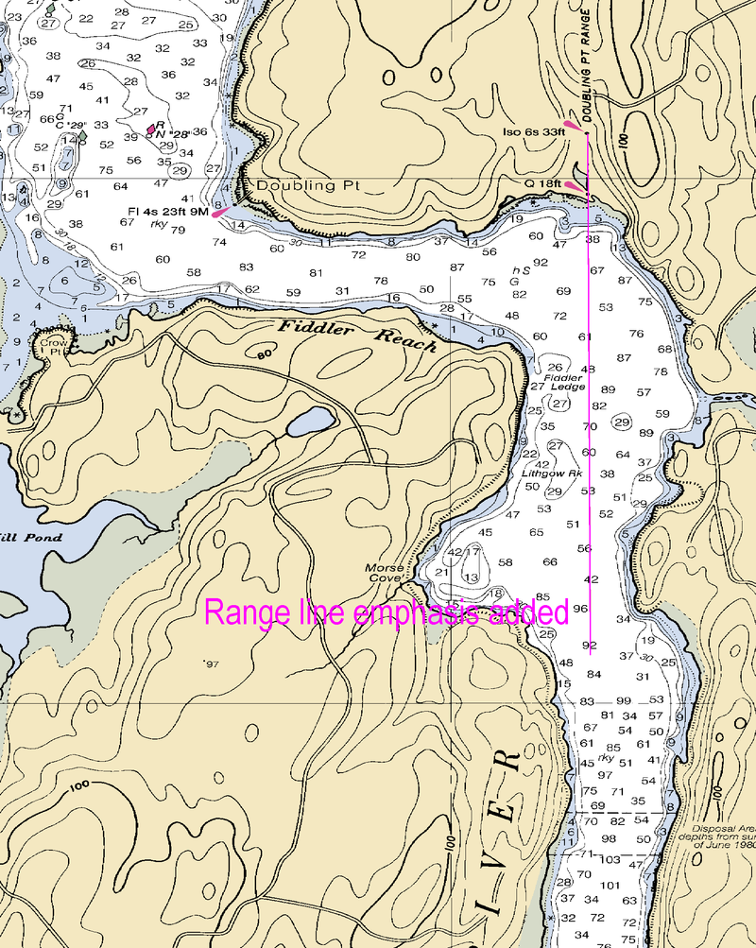
Examples of how a GUID from another domain may look among other product producer generated MRN IDs;
Feature: Recommended Track
Attribute: category of recommended track: Based on a system of fixed marks
Attribute: orientation: 270 degrees
Attribute: MRN: urn:mrn:iho:s101:jsho:12345678
Feature: Navigational Line
Attribute: category of navigation line: leading line bearing a recommended track
Attribute: orientation: 270 degrees
Attribute: MRN: urn:mrn:iho:s101:jsho:87654321
Feature: Landmark
Attribute: category of landmark: tower
Attribute: function: light support
Attribute: MRN: urn:mrn:iala:s201:jscg:54321678
Feature: Light
Attribute: category of light: leading light
Attribute: colour: white
Attribute: MRN: urn:mrn:iala:s201:jscg:45678123
Feature: Range System
Attribute: name: Micklefirth approach range
Attribute MRN: urn:mrn:iho:s101:jsho:23456781
Aggregation: Range System Aggregation
Consists of: MRN: urn:mrn:iho:s101:jsho:12345678
Consists of: MRN: urn:mrn:iho:s101:jsho:87654321
Consists of: MRN: urn:mrn:iala:s201:jscg:54321678
Consists of: MRN: urn:mrn:iala:s201:jscg:45678123
Doubling Point Range Lights on NOAA chart 13296. (Image from Wikipedia.com)

